Slide 1
Recovering Clipped OFDM Symbols with Bayesian Inference
Jinkun Zhang

Slide 2
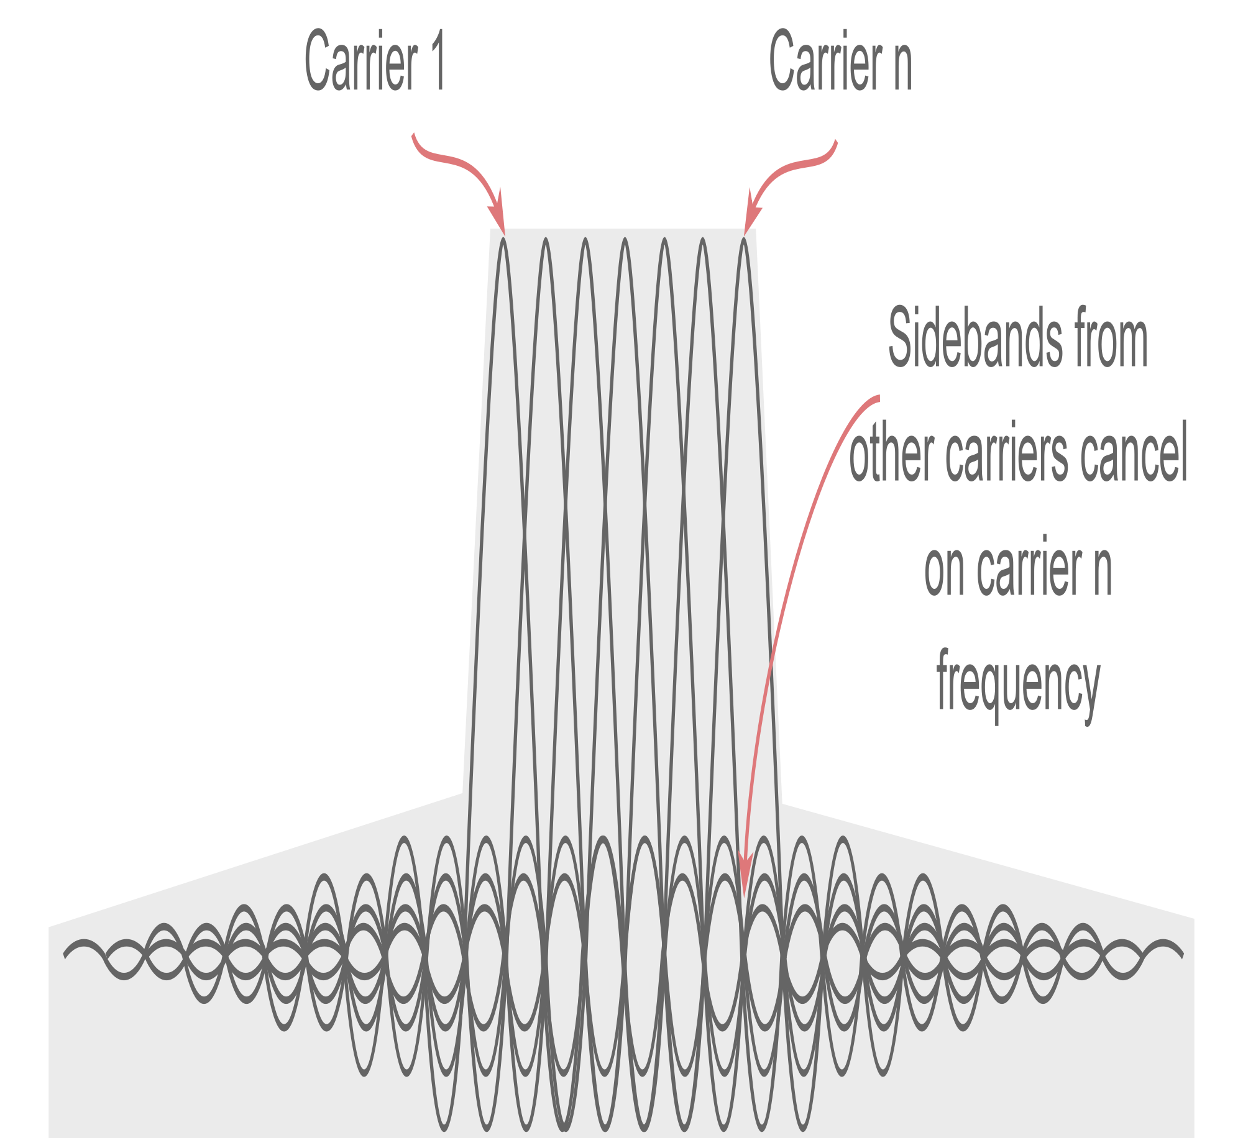
OFDM System
Orthogonal Frequency-Division Multiplexing (OFDM) is a method of encoding digital data on multiple orthogonal carrier frequencies.
OFDM was first introduced in 1966 (Bell Lab)
OFDM is one of the basic idea of 4G LTE. 1G -> Analog System 2G -> TDMA, CDMA 3G -> CDMA-2000 4G -> OFDM 5G -> Massive MIMO

Slide 3

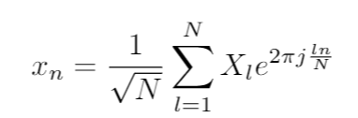
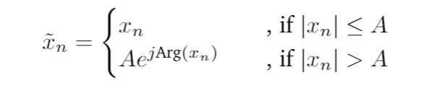
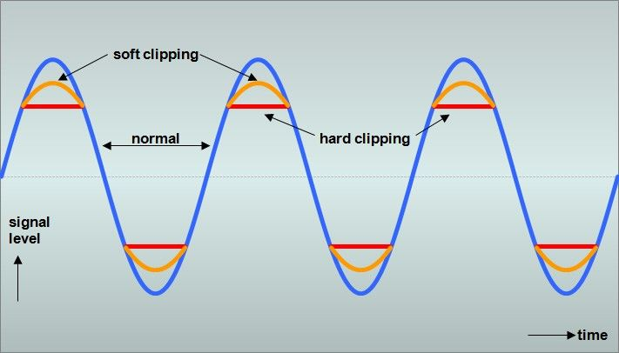
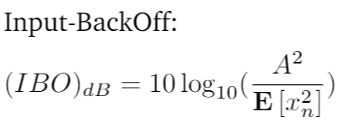
Clipping Distortion
Frequency domain signal is drawn from a finite set (Constellation)
Time domain signal may have high peak power

Slide 4
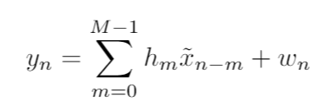
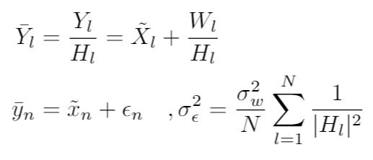
Channel
We assume time invariant frequency selective channel
Also assume perfect sync. and equalization

Slide 5
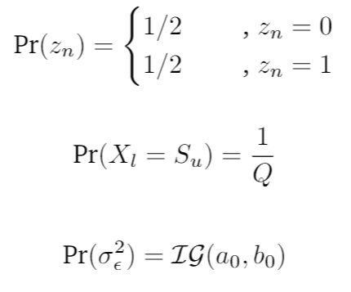
MAP Approach
Set hyperparameter z_{n}
Prior

Slide 6
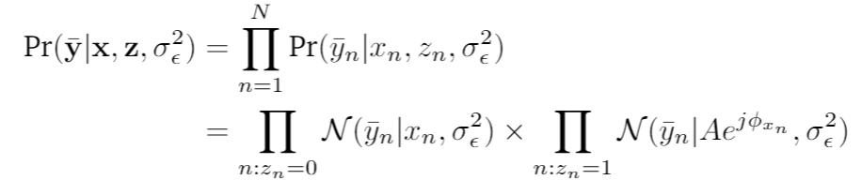
MAP Approach
Likelihood
Directly maximizing the full posterior w.r.t all variables would be hard to implement because the parameter space is too large

Slide 7
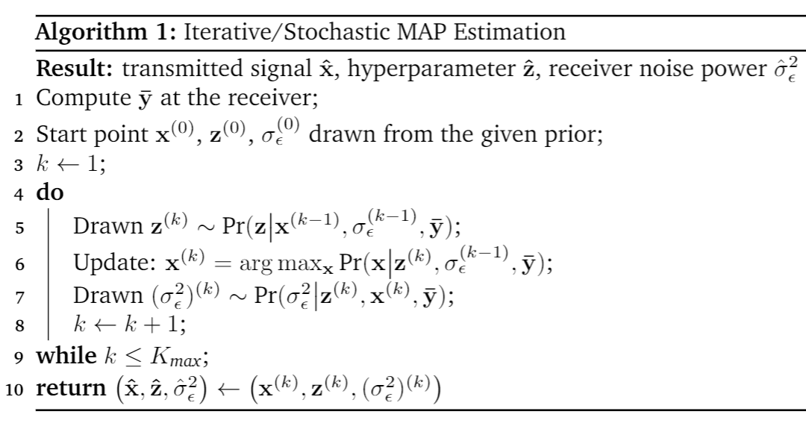
Iterative MAP Approach
We introduce iterative/stochastic algorithm, update each variable separately.
This approach can be interpreted as an extension of EM strategy.

Slide 8


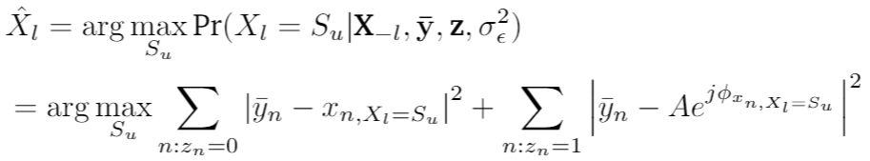
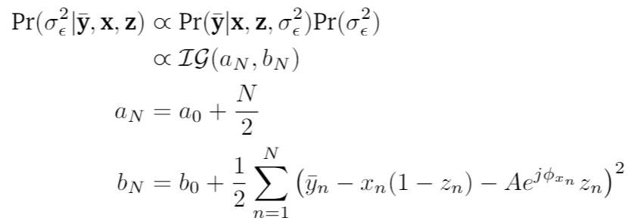
Iterative MAP Approach (Algorithm)
Detail conditional posterior
z_{n}
X_{l}
σ_{ε}

Slide 9
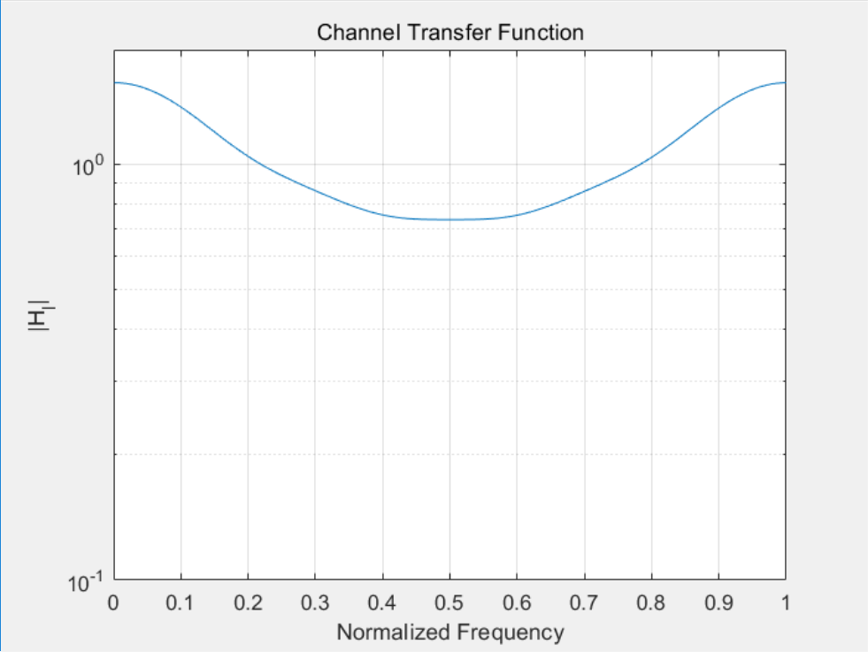
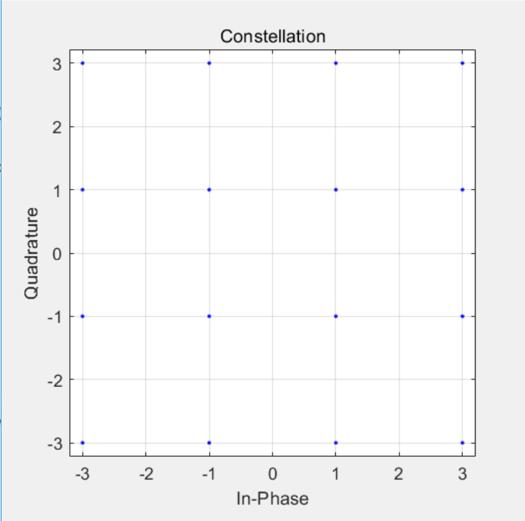
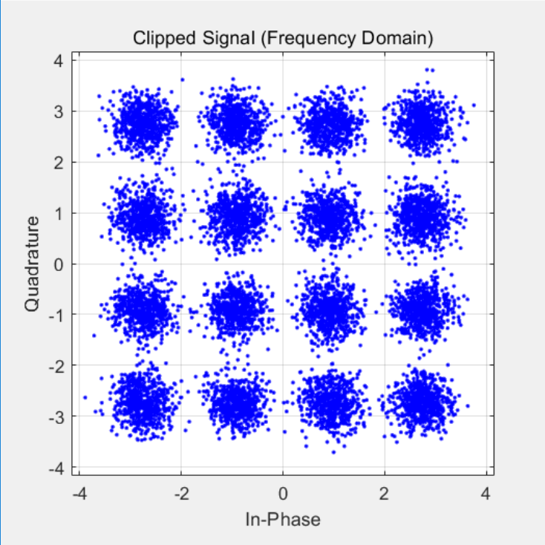
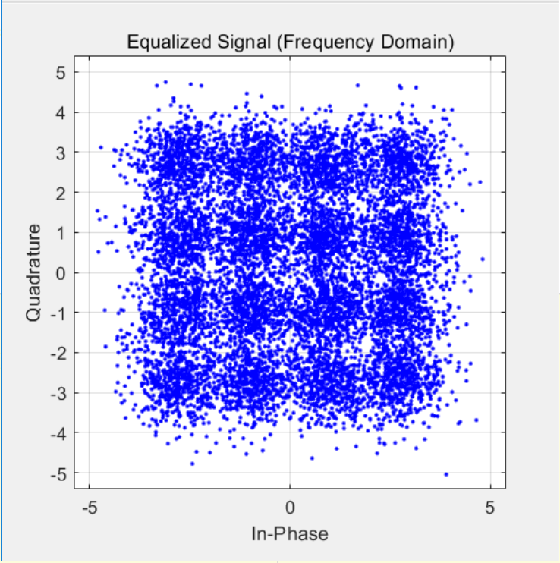
Implementation
Simple convolution channel
16QAM Constellation

Slide 10
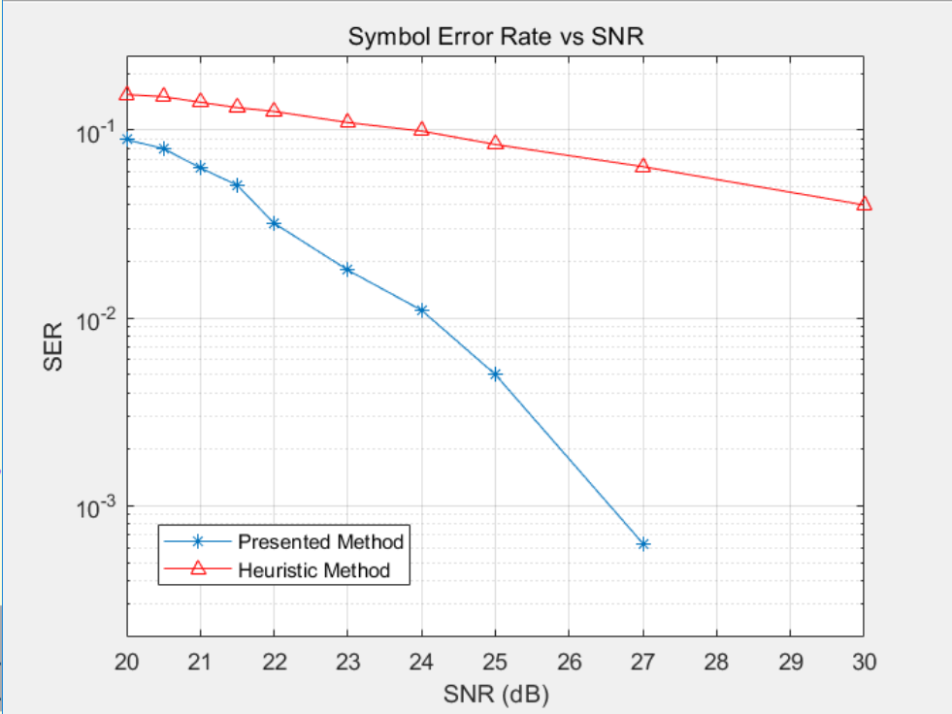
Implementation
N = 100000, IBO = 2.93dB, K_{Max} = 10
20 trails
Time Complexity: O(KQN²)

